Slide 1

50.039 Theory and Practice of Deep Learning W3-S1 Introduction to Deep Learning using the PyTorch framework
Matthieu De Mari

Slide 2
Introduction (Week 3)
What is the PyTorch library and its benefits?
What is a PyTorch tensor object and its typical attributes?
How to implement some typical tensor operations?
What is broadcasting on tensors?
What are tensor locations in terms of computation?
How to transform our original NumPy shallow Neural Network class so it uses PyTorch now instead?
How to implement a forward, loss and accuracy metric in PyTorch?
What are some measurable performance benefits of using PyTorch over NumPy and GPUs over CPUs?

Slide 3
Introduction (Week 3)
What is the autograd/backprop module in PyTorch, and how does it use a computational graph to compute all derivatives?
How to use the autograd to implement derivatives and a vanilla gradient descent?
How to implement backprop in PyTorch for our shallow Neural Network class?
How to use PyTorch to implement advanced optimizers?
How to use PyTorch to implement advanced initializers?
How to use PyTorch to implement regularization?
How to finally revise our trainer function to obtain a minimal, yet complete Neural Network in PyTorch?

Slide 4
Introduction (Week 3)
What are the Dataset and Dataloader objects in PyTorch?
How to implement a custom Dataloader and Dataset object in PyTorch?
How to move from binary classification to multi-class classification?
How to adjust output probabilities using the softmax function?
How to change the cross-entropy loss so it works in multi-class classification?
How to implement building blocks in PyTorch?
How to implement and train our first Deep Neural Network?
What are additional good practices in PyTorch?

Slide 5
Hyperparameters tuning and searching
Definition (hyperparameters tuning and searching):
Earlier, we have identified that several parameters in our neural networks had to be manually decided by the user and called those hyperparameters.
Unfortunately, the NFL theorem tells us there is often no closed-form formula to tell you what is the best value to use for those hyperparameters.
Typical hyperparameters include:
Number of layers and their sizes,
Initializers to use for parameters,
Activation functions to use,
Learning rate, momentum and other parameters related to optimizers,
Etc.
No choice: try different values and possibilities.

Slide 6
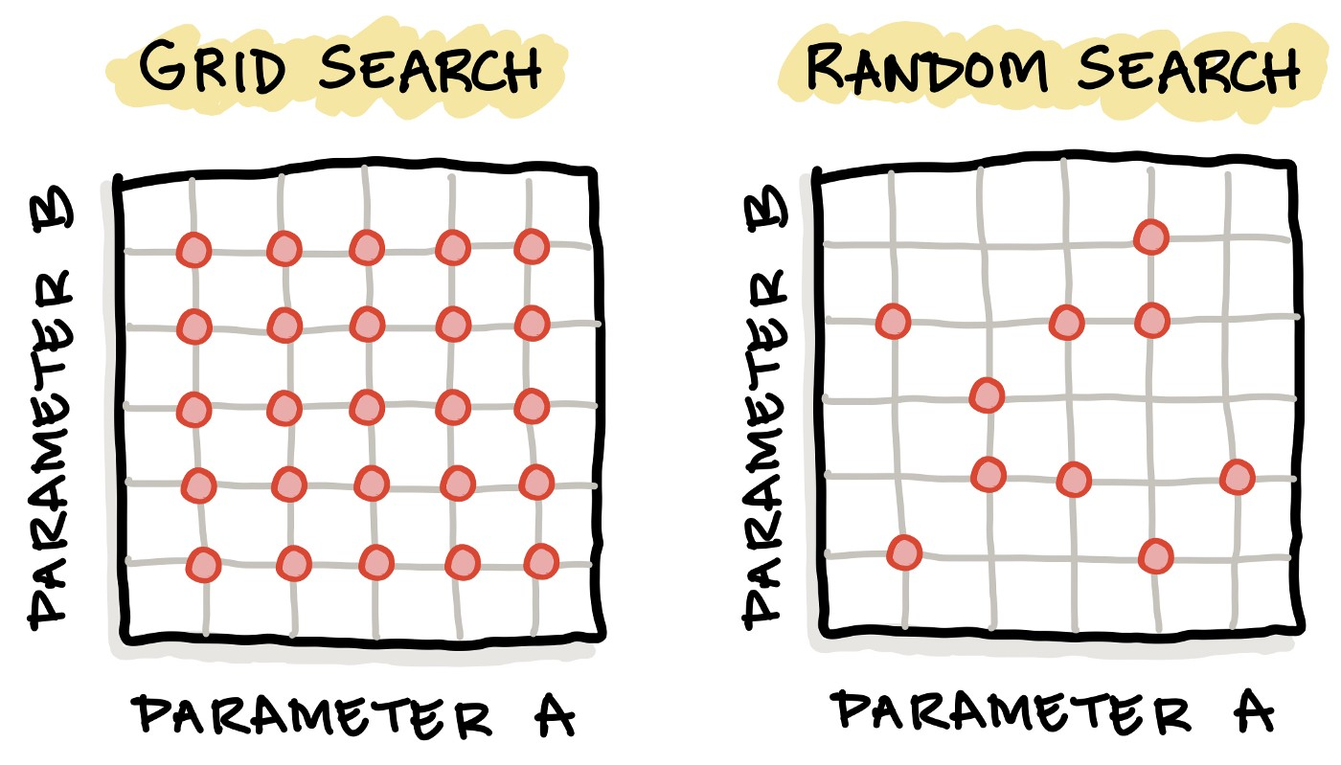
Hyperparameters tuning and searching
Definition (hyperparameter grid searching):
Grid search is the simplest algorithm for hyperparameter tuning.
Basically, we divide the domain of possible values for each of the hyperparameters into a discrete grid. Then, we will try every combination of values of this grid, calculating some performance metrics.

Slide 7
Hyperparameters tuning and searching
Definition (hyperparameter random searching):
Random search is the another algorithm for hyperparameter tuning.
Random search defines a search space as a bounded domain of hyperparameter values and randomly sample points in that domain. After trying enough values, keep the best hyperparameters configuration.

Slide 8
Hyperparameters tuning and searching
In general ([HypSearch]),
grid search is often better on small spaces,
whereas random search is better on large domains, but has no guarantee of returning a good configuration.
More advanced techniques than these two exist, such as Bayesian Optimization and Evolutionary Optimization.

Slide 9

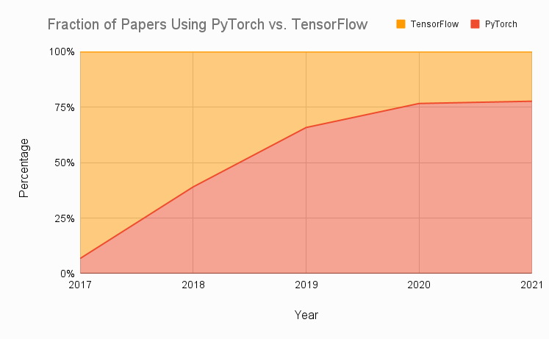
Technical pre-requisites
Framework of choice will be PyTorch! (not Tensorflow, not Keras, not MXNet, etc.)
Increasing popularity and preferred to Google’s Tensorflow these days for many reasons.
Learn more, if curious: https://www.assemblyai.com/blog/pytorch-vs-tensorflow-in-2022/

Slide 10
On the benefits of using PyTorch
There are several benefits to using PyTorch over NumPy for implementing neural networks:
More intuitive interface for working with tensors and neural networks.
NumPy is primarily a numerical computing library.
PyTorch is specifically designed with deep learning, and provides a more natural and convenient interface.
Large active community of users.
Many tutorials, detailed documentations and implementations on Github.
Stack overflow equivalent.
PyTorch has better support for GPU acceleration than NumPy.
If a GPU is available, significantly speed up the training of our neural network by performing the computations on the GPU using PyTorch.
Especially useful for training large and complex models.
High-level abstractions for building and training neural networks.
Easier to write and debug code,
Improve the performance of our model by allowing PyTorch to apply optimization techniques
More specifically, automatic differentiation!

Slide 11
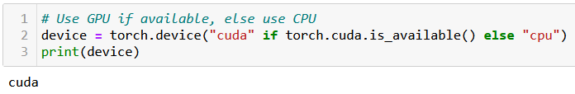
At this point, you should have installed PyTorch, and if possible, CUDA
You can check for CUDA/GPU capabilities, using the line below. If the CUDA has not been properly installed or the GPU is not compatible, you will be using a CPU instead.
We strongly advise to take a moment to make sure your machine is CUDA enabled, assuming your GPU is compatible. When CUDA is properly installed on a compatible GPU, the line below should display cuda, otherwise it will print cpu.

Slide 12
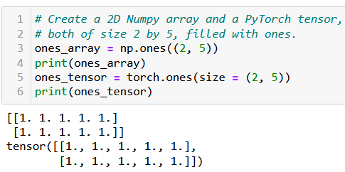
The Tensor object
Definition (Tensor):
The tensor is PyTorch's basic building block and is similar to NumPy arrays.
This is why most of the concepts and methods will look similar
However, these come with additional features, which will be useful later on when building Neural Networks with these tensors.

Slide 13
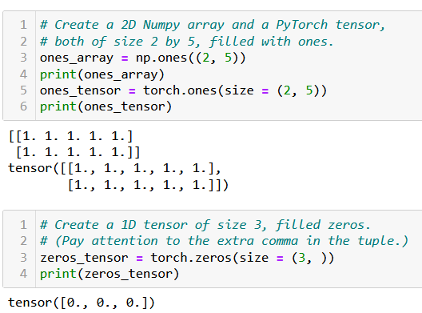
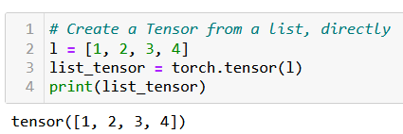
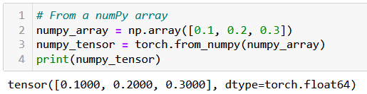
Creating a Tensor
Tensors can be simply created as in NumPy, by using zeros() or ones() functions, specifying dimensions of the expected Tensor, with tuples.
They can also be created from a list (of lists) of values, by passing it to the tensor() function.
Or from a Numpy array, using the from_numpy() method.

Slide 14
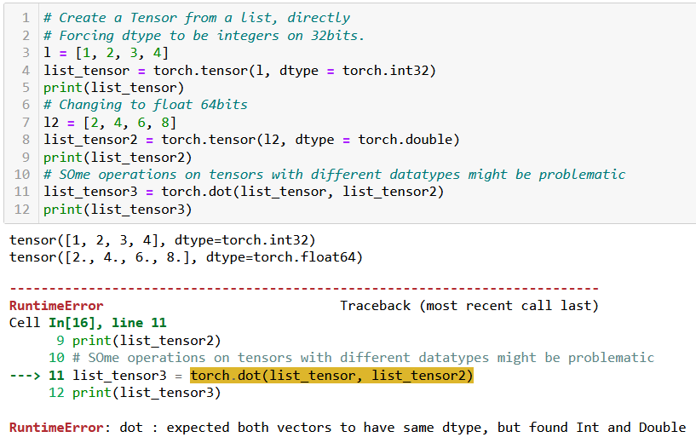
Tensor datatypes (dtypes)
Definition (dtypes):
PyTorch tensors have an attribute called dtype, which tracks the datatype of values stored in the tensor.
See link below for more details on the possible dtypes. https://www.tensorflow.org/api_docs/python/tf/dtypes
In general, operations between tensors require compatible, and sometimes identical dtypes.
Here, the dot product failed because one tensor was int, and the other was float/double.

Slide 15
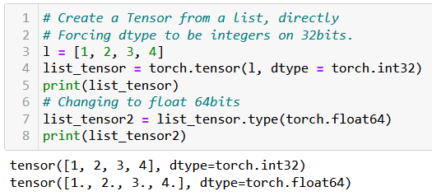
Tensor datatypes (dtypes)
Definition (dtypes):
PyTorch tensors have an attribute called dtype, which tracks the datatype of values stored in the tensor.
See link below for more details on the possible dtypes. https://www.tensorflow.org/api_docs/python/tf/dtypes
In general, operations between tensors require compatible, and sometimes identical dtypes.
You can change the dtype of a tensor
- by either specifying it explicitly during its creation;
- or by using the type() method on the tensor, casting a new dtype.

Slide 16
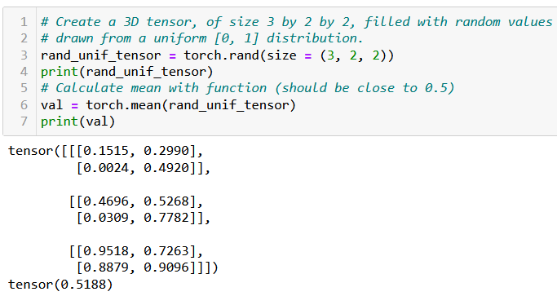
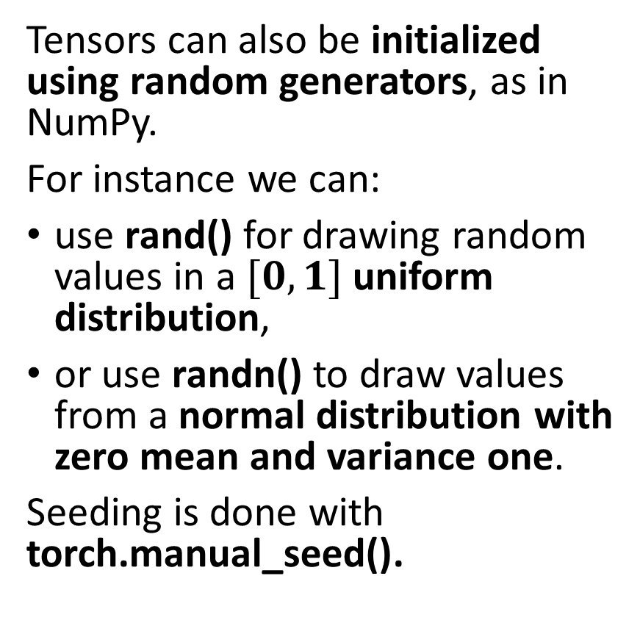
Tensor random initializers
Tensors can also be initialized using random generators, as in NumPy.
For instance we can:
use rand() for drawing random values in a $[0, 1]$uniform distribution,
or use randn() to draw values from a normal distribution with zero mean and variance one.
Seeding is done with torch.manual_seed().
Functions and methods exist for calculating mean values of a tensor, its standard deviation/variance, etc.

Slide 17
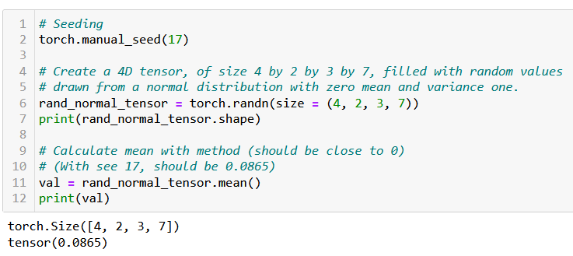
Tensor random initializers
Tensors can also be initialized using random generators, as in NumPy.
For instance we can:
use rand() for drawing random values in a $[0, 1]$uniform distribution,
or use randn() to draw values from a normal distribution with zero mean and variance one.
Seeding is done with torch.manual_seed().
Functions and methods exist for calculating mean values of a tensor, its standard deviation/variance, etc.

Slide 18

Additional attributes of Tensors
Tensors come with many attributes and methods, e.g. asking the shape of a tensor, like in NumPy, is done using the shape attribute.

Slide 19
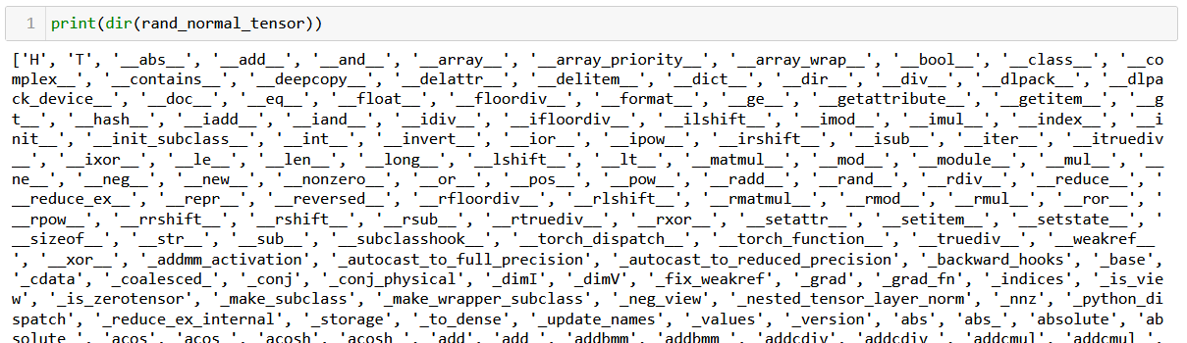
Additional attributes of Tensors
Tensors come with many attributes and methods, e.g. asking the shape of a tensor, like in NumPy, is done using the shape attribute.
Too many of them for me to cover, so RTFM!

Slide 20
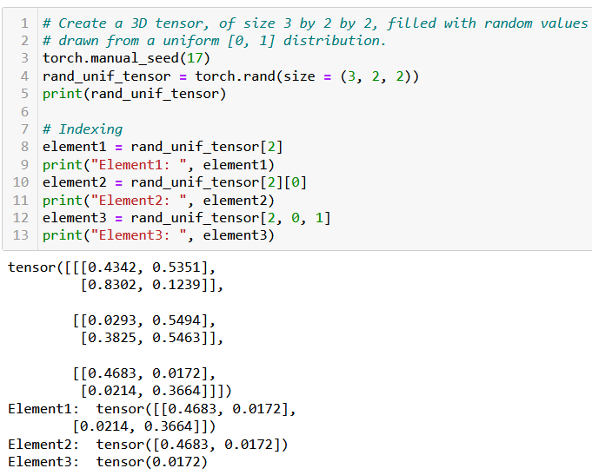
Basic operations on Tensors
All the typical element-wise operations work on tensors. For instance, we can:
access elements using the square bracket notation, multiple square bracket notations and multiple indexes in a single square bracket;
slice a tensor using the square bracket notation and colon symbol;
update elements of a tensor using the square bracket notation;
browse through elements of a tensor using a for loop.

Slide 21
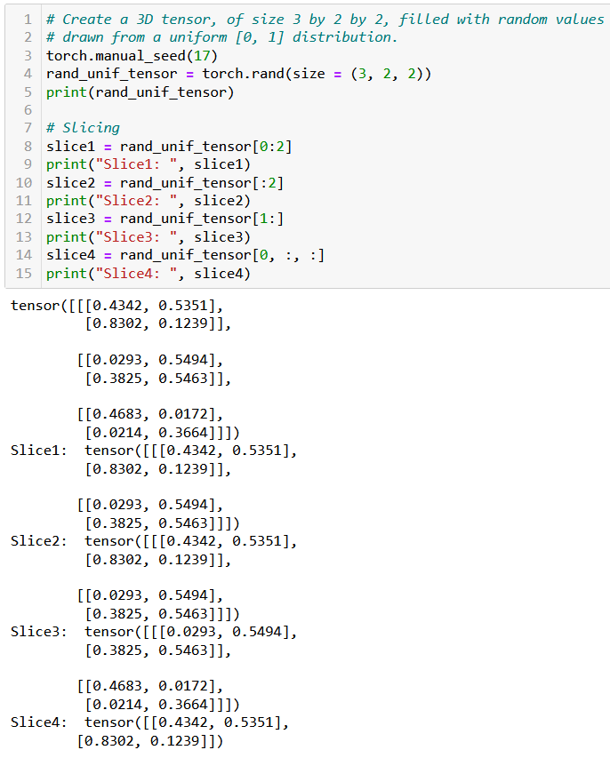
Basic operations on Tensors
All the typical element-wise operations work on tensors. For instance, we can:
access elements using the square bracket notation, multiple square bracket notations and multiple indexes in a single square bracket;
slice a tensor using the square bracket notation and colon symbol;
update elements of a tensor using the square bracket notation;
browse through elements of a tensor using a for loop.

Slide 22
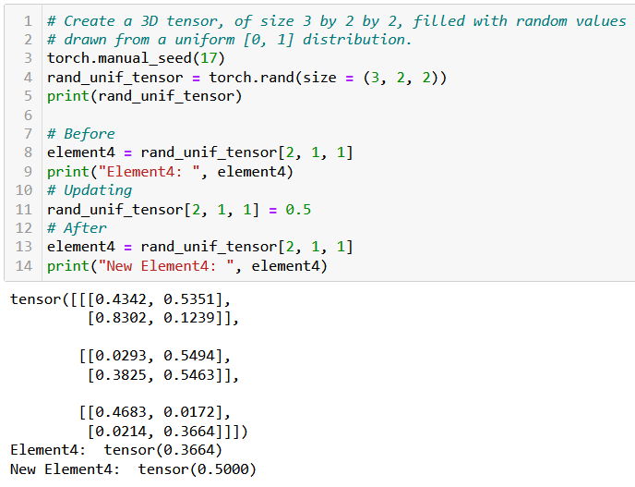
Basic operations on Tensors
All the typical element-wise operations work on tensors. For instance, we can:
access elements using the square bracket notation, multiple square bracket notations and multiple indexes in a single square bracket;
slice a tensor using the square bracket notation and colon symbol;
update elements of a tensor using the square bracket notation;
browse through elements of a tensor using a for loop.

Slide 23
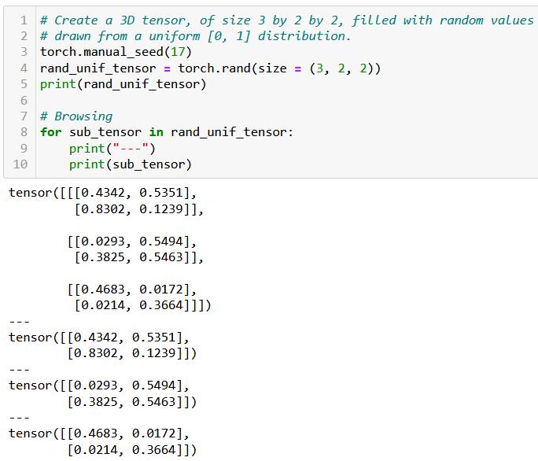
Basic operations on Tensors
All the typical element-wise operations work on tensors. For instance, we can:
access elements using the square bracket notation, multiple square bracket notations and multiple indexes in a single square bracket;
slice a tensor using the square bracket notation and colon symbol;
update elements of a tensor using the square bracket notation;
browse through elements of a tensor using a for loop.

Slide 24

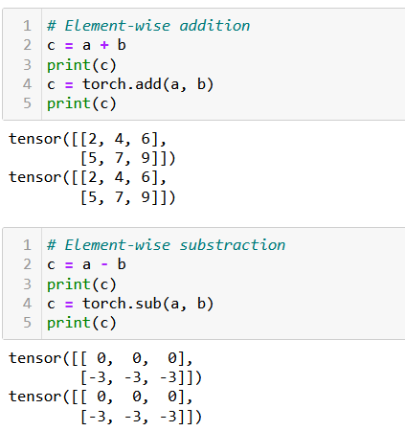
Arithmetic operations on Tensors
All NumPy array operations work on Tensors and equivalent methods have been written in torch as well.
Element-wise Addition/Subtraction,
Element-wise Multiplication/Division,
Transposition,
Matrix multiplication and dot product,
Etc.

Slide 25
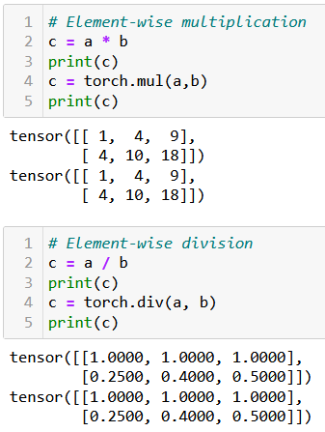
Arithmetic operations on Tensors
All NumPy array operations work on Tensors and equivalent methods have been written in torch as well.
Element-wise Addition/Subtraction,
Element-wise Multiplication/Division,
Transposition,
Matrix multiplication and dot product,
Etc.

Slide 26
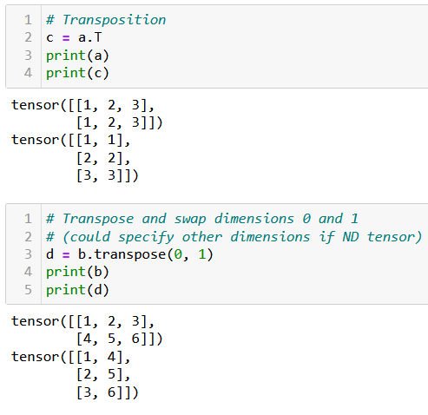
Arithmetic operations on Tensors
All NumPy array operations work on Tensors and equivalent methods have been written in torch as well.
Element-wise Addition/Subtraction,
Element-wise Multiplication/Division,
Transposition,
Matrix multiplication and dot product,
Etc.

Slide 27
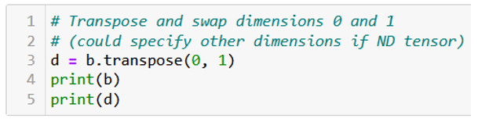
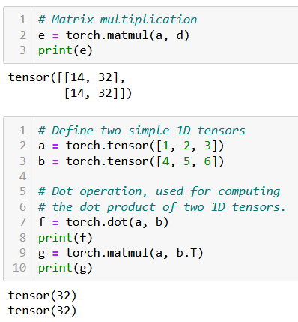
Arithmetic operations on Tensors
All NumPy array operations work on Tensors and equivalent methods have been written in torch as well.
Element-wise Addition/Subtraction,
Element-wise Multiplication/Division,
Transposition,
Matrix multiplication and dot product,
Etc.

Slide 28
A quick note on broadcasting
Tensors, just like NumPy arrays, support broadcasting.
Two tensors are “broadcastable” if the following rules hold:
Each tensor has at least one dimension.
When iterating over the dimension sizes, starting at the trailing dimension, the dimension sizes must either be equal, one of them is 1, or one of them does not exist.
If two tensors x, y are “broadcastable”, the resulting tensor size is calculated as follows:
If the number of dimensions of x and y are not equal, prepend 1 to the dimensions of the tensor with fewer dimensions to make them equal length.
Then, for each dimension size, the resulting dimension size is the max of the sizes of x and y along that dimension.

Slide 29
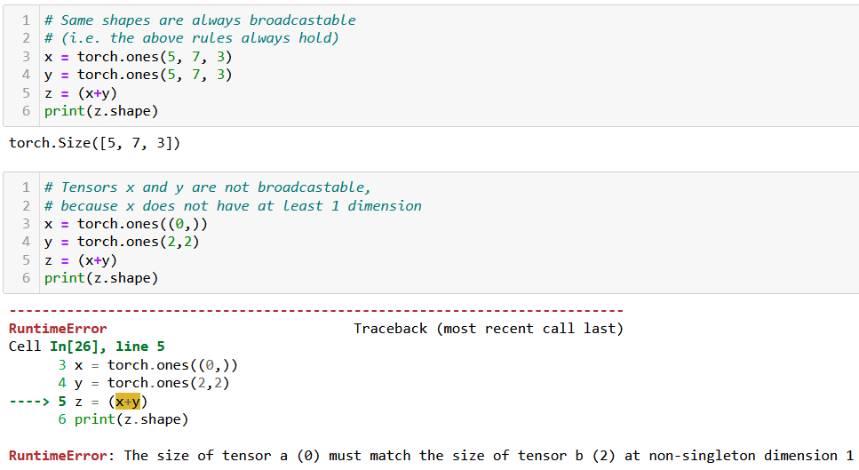
A quick note on broadcasting

Slide 30
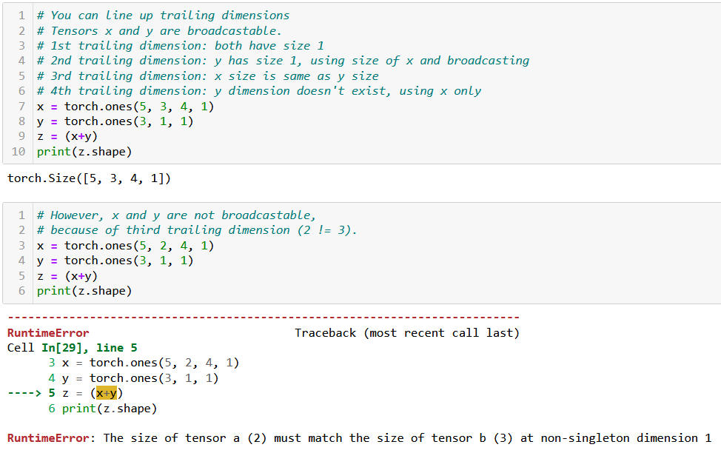
A quick note on broadcasting

Slide 31

Tensor locations
Recall: PyTorch has better support for GPU acceleration than NumPy.
If a GPU is available, significantly speed up the training of our neural network by performing the computations on the GPU using PyTorch.
Especially useful for training large and complex models.

Slide 32
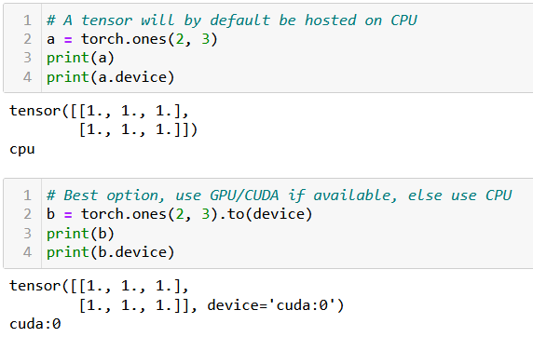
Tensor locations
By default, all tensors are used by the CPU. If device enabled for GPU/CUDA computation, transfer the tensor to the GPU for faster computation.
This is done in three ways:
Using .to(device) method will transfer to the best device available for computation (device variable defined earlier, when we checked for cuda/cpu).
Using .cpu() or .cuda() will force transfer to the cpu or cuda respectively. Note that it might fail if you machine is not CUDA compatible.

Slide 33
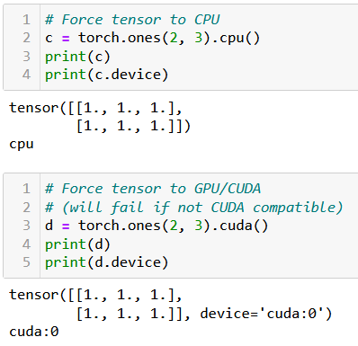
Tensor locations
By default, all tensors are used by the CPU. If device enabled for GPU/CUDA computation, transfer the tensor to the GPU for faster computation.
This is done in three ways:
Using .to(device) method will transfer to the best device available for computation (device variable defined earlier, when we checked for cuda/cpu).
Using .cpu() or .cuda() will force transfer to the cpu or cuda respectively. Note that it might fail if you machine is not CUDA compatible.

Slide 34
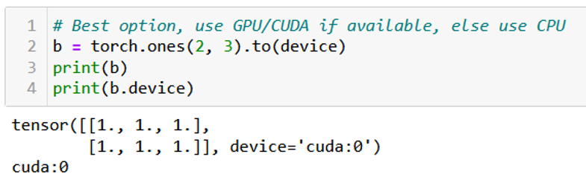
Tensor locations
By default, all tensors are used by the CPU. If device enabled for GPU/CUDA computation, transfer the tensor to the GPU for faster computation.
This is done in three ways:
Using .to(device) method will transfer to the best device available for computation (device variable defined earlier, when we checked for cuda/cpu).
Using .cpu() or .cuda() will force transfer to the cpu or cuda respectively. Note that it might fail if you machine is not CUDA compatible.
In doubt, you can check the device attribute of your tensors to find where their computations will occur.

Slide 35
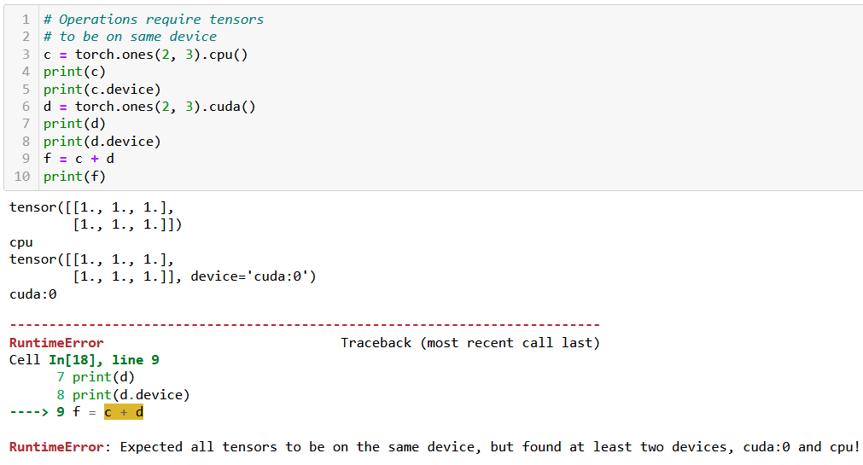
Tensor locations
Keep in mind: two tensors with different devices cannot be used in the same operation! (same logic as dtypes).

Slide 36
A bit of practice for you to try at home
In order to practice your PyTorch Tensor skills, you may try to manually implement your own version of typical algorithms we ran on lists/Numpy arrays in previous classes, using the basic operations on PyTorch tensors.
For instance, try writing algorithms:
Finding the maximum, minimum, average, median values of a given 1D tensor,
Transposing a given 2D tensor,
Sorting a given 1D tensor (bubble sort, insertion sort, selection sort, quick sort, merge sort),
Generating a 1D array containing the first K Fibonacci numbers with K given,
Etc.
Later, you can check their performance times compared to their numpy/pytorch implementations when running them on both CPU and CUDA (if available).
In which scenarios is it slower to implement said functions and run them on GPU?

Slide 37
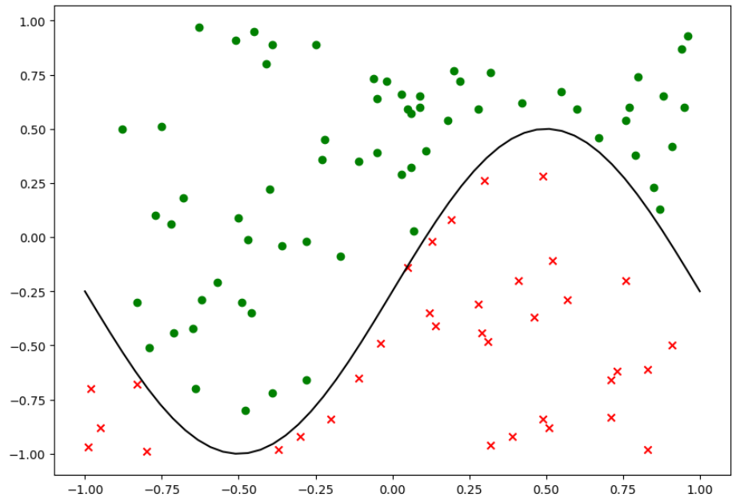
Same dataset as before

Slide 38
Our shallow neural network class
We will reuse our previous ShallowNeuralNet class from Week2 Notebook 7, which:
implements a Shallow neural network using two fully connected layers and sigmoid activation functions,
uses a Stochastic Mini-Batch gradient descent, with Adam as its optimizer,
uses a random normal initialization,
comes with a forward() method for predictions,
comes with a backward() and train() method for backpropagation training,
comes with a cross-entropy loss function and an accuracy calculating loss function,
comes with a display function, to show training curves on both the loss and the accuracy,
comes with save and load functions.
Let us start by replicating the init, forward, loss and accuracy methods in PyTorch.

Slide 39
Writing a PyTorch neural network
The main differences between the original class and the PyTorch version are:
The PyTorch version of the class should inherit from torch.nn.Module and call its parent's init method using super().
This is necessary because PyTorch uses classes inherited from torch.nn.Module to keep track of the layers and their parameters in a neural network.
Instead of using NumPy arrays for the weights and biases, the PyTorch version uses torch.nn.Parameter objects, which is a subclass of tensors, whose values can be trained and modified later.

Slide 40
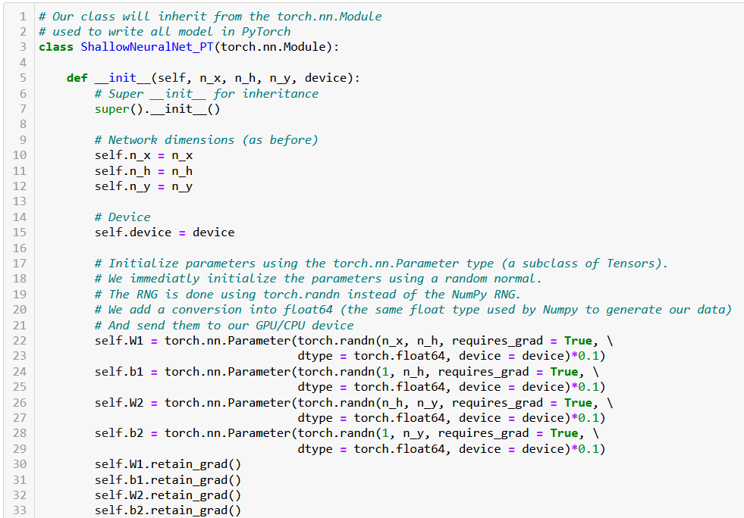

Slide 41
Writing a PyTorch neural network
In PyTorch, retain_grad is an attribute of tensors that allows the gradients to be accumulated for a particular tensor, during backpropagation.
Setting retain_grad to True for a tensor will tell PyTorch to keep track of operations happening during the forward pass, later allowing to compute the gradients of intermediate tensors.
This will eventually serve to perform parameters updates via backpropagation.
To keep it simple: Trainable parameters should allow for gradients to be retained for backpropagation.

Slide 42
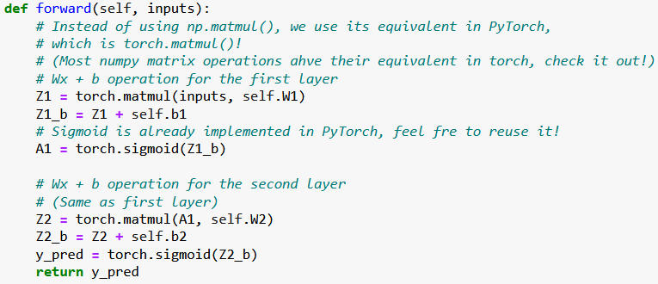
Rewriting the forward pass
The forward pass can be rewritten. You can replace the NumPy operations with their PyTorch equivalents. Similarly, our activation function sigmoid is replaced with PyTorch's torch.sigmoid function.

Slide 43
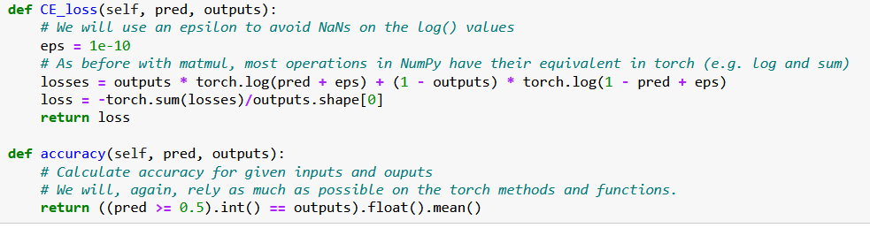
Rewriting the loss and accuracy functions
Similarly, we can rewrite the loss and accuracy functions using torch functions in place of the Numpy ones, also vectorizing operations as much as possible.

Slide 44
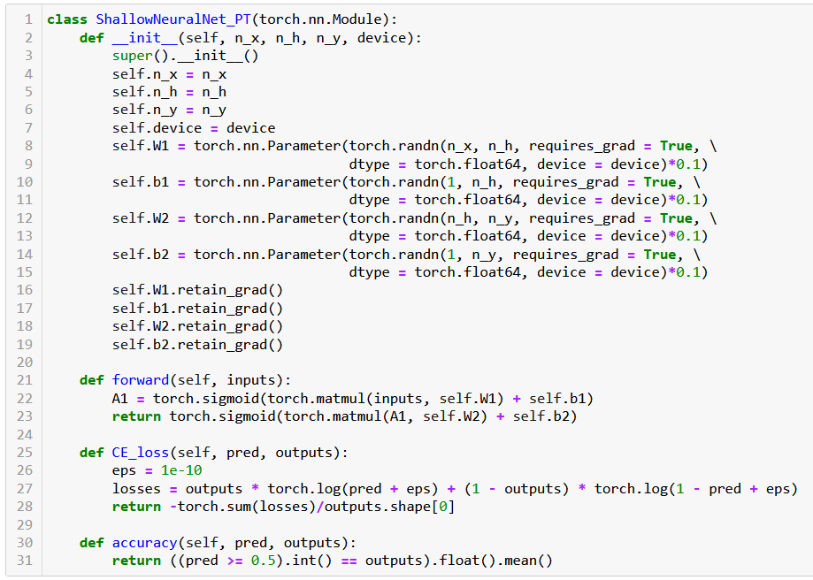

Slide 45
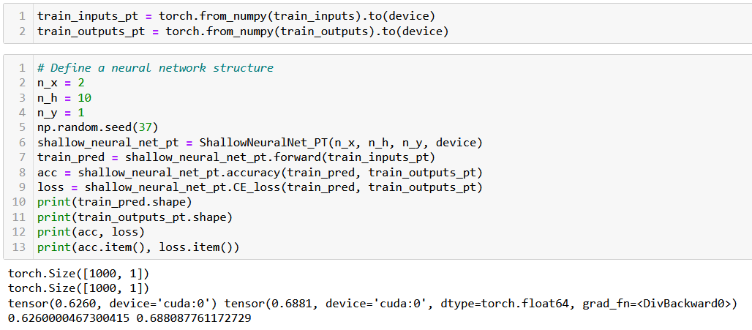
Trying out our new neural network
Before using this Neural Network on our dataset, we need to convert them to PyTorch Tensor objects and send them to GPU (if available).

Slide 46
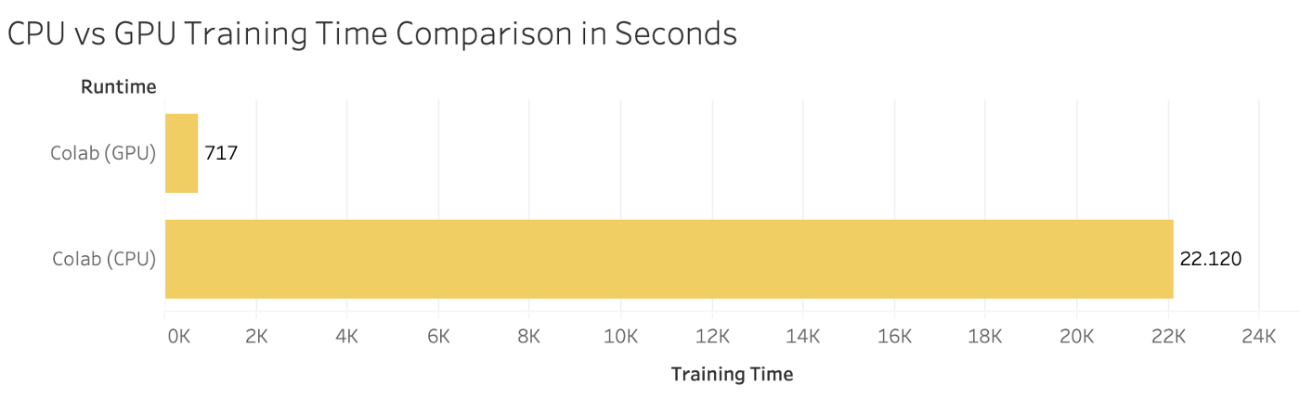
Computation times comparison
Let us run both models (the NumPy one and the PyTorch one) and ask them to perform 1000 times the accuracy computation.
On my machine (CUDA, Nvidia GTX 1060), the PyTorch model is roughly 30 times faster!
Obviously depends on your machine (could achieve even more).

Slide 47
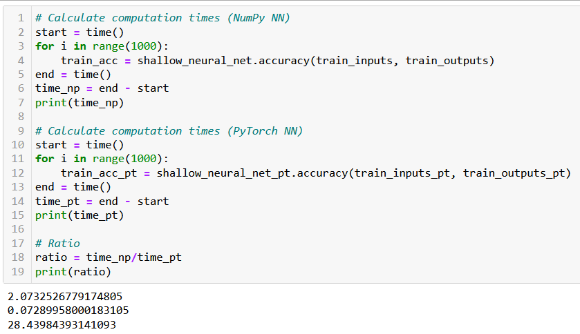
Computation times comparison

